Slide 1
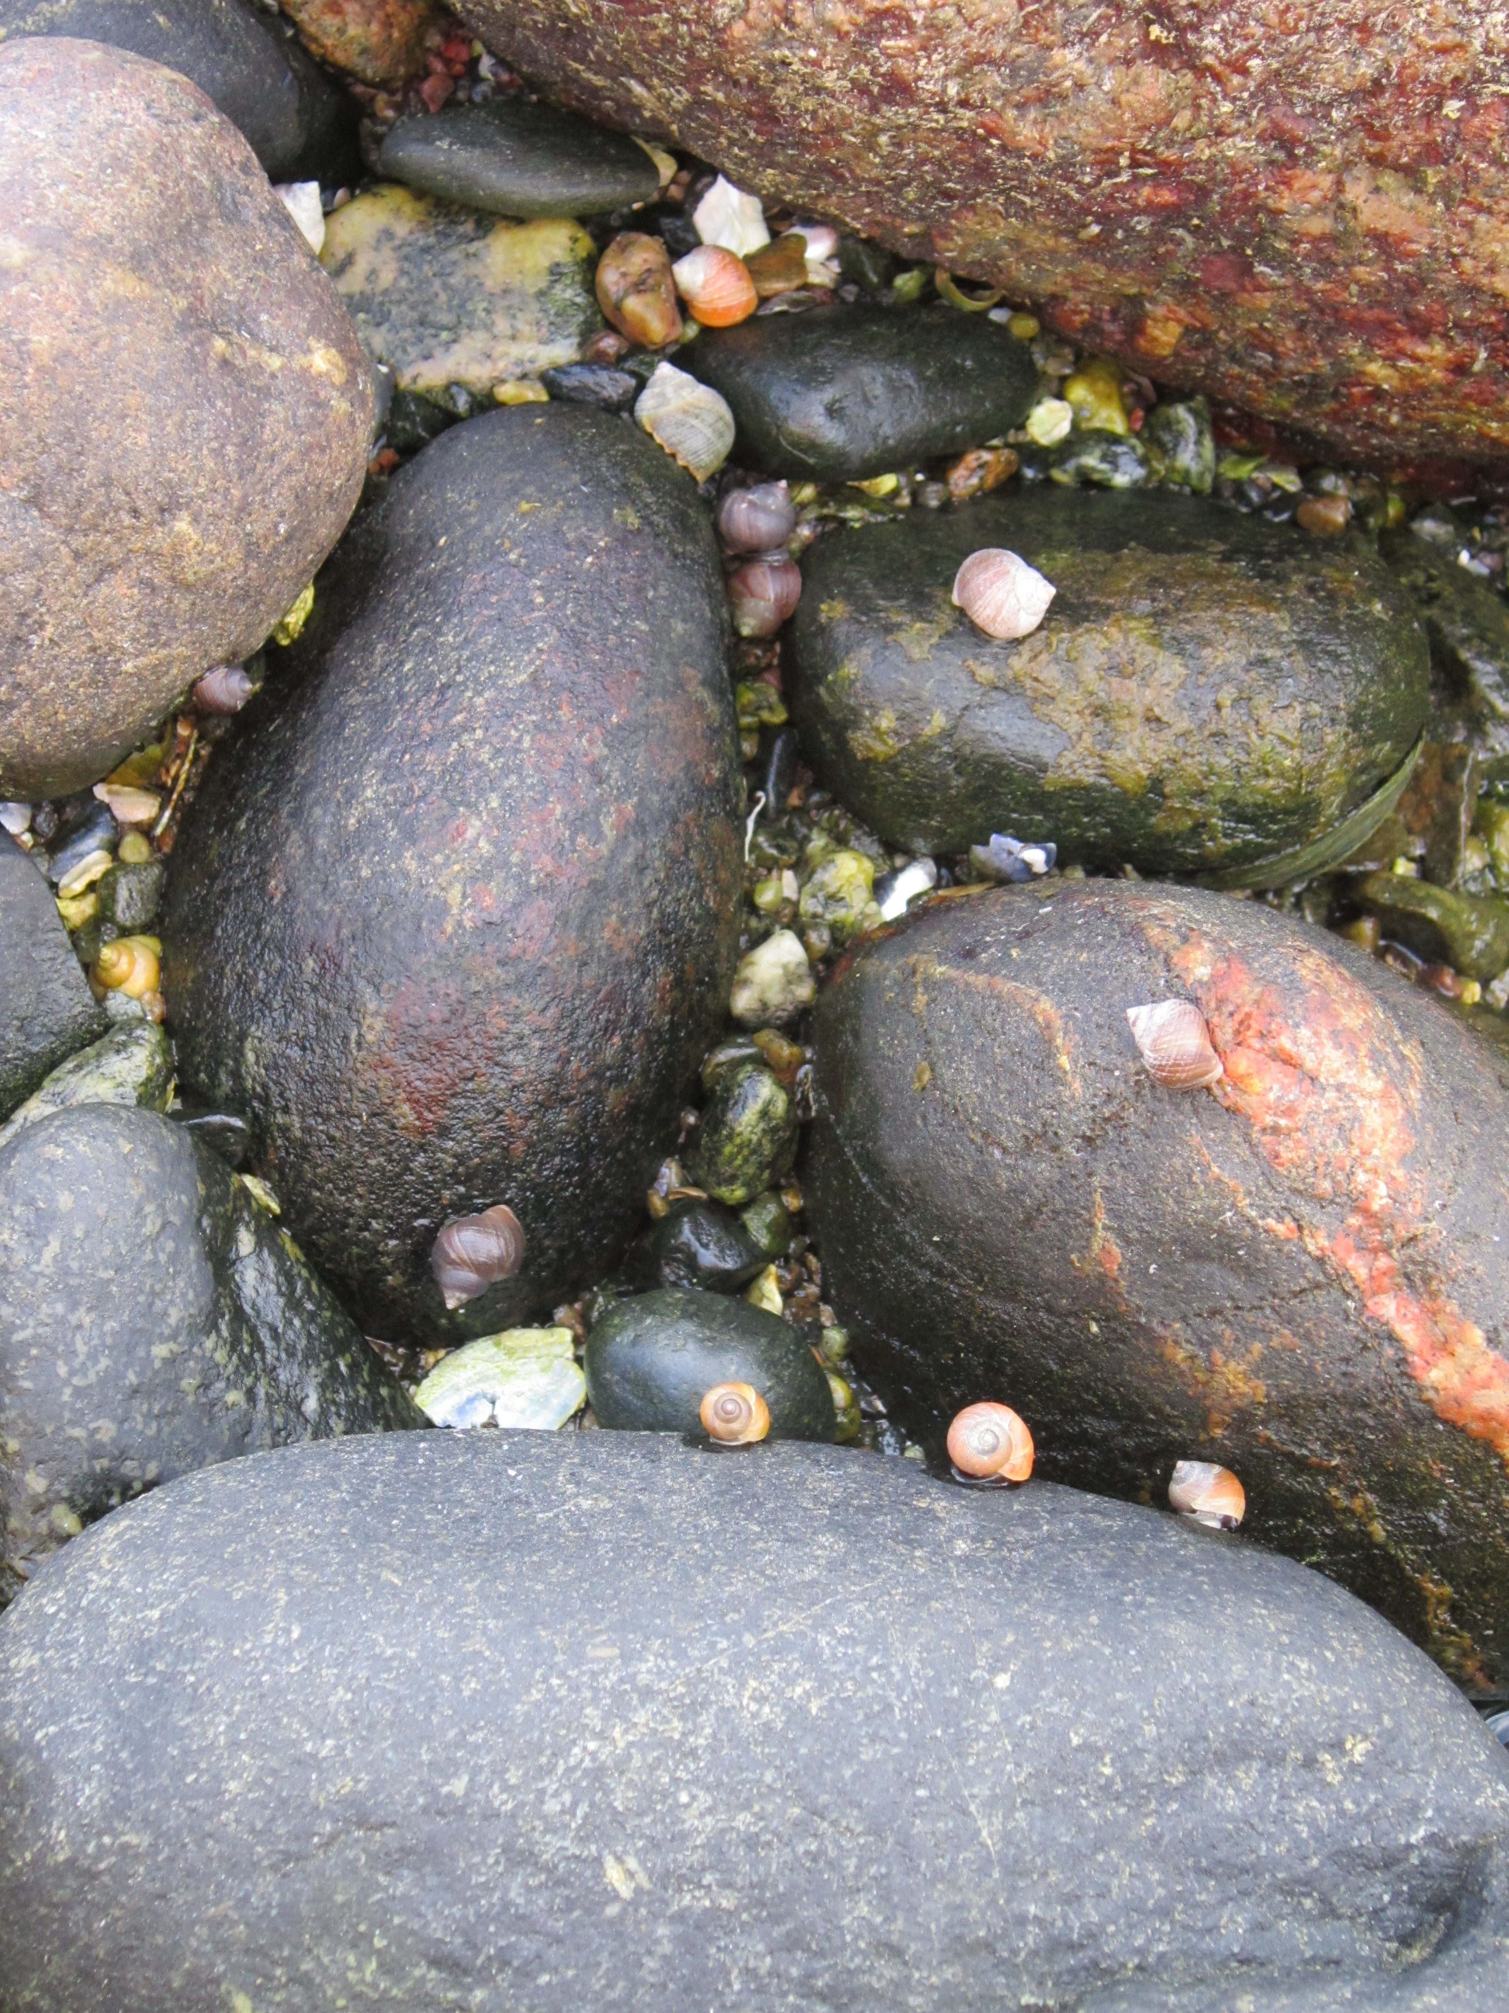
RAD sequencing reveals parallel and non-parallel genomic divergence in Swedish Littorina saxatilis populations
Mark Ravinet^{1, 2}, Marina Panova², Roger Butlin^{2, 3}, Kerstin Johannesson², Carl André²
National Institute of Genetics, Japan
University of Gothenburg, Sweden
University of Sheffield, UK
mravinet@nig.ac.jp

Slide 2
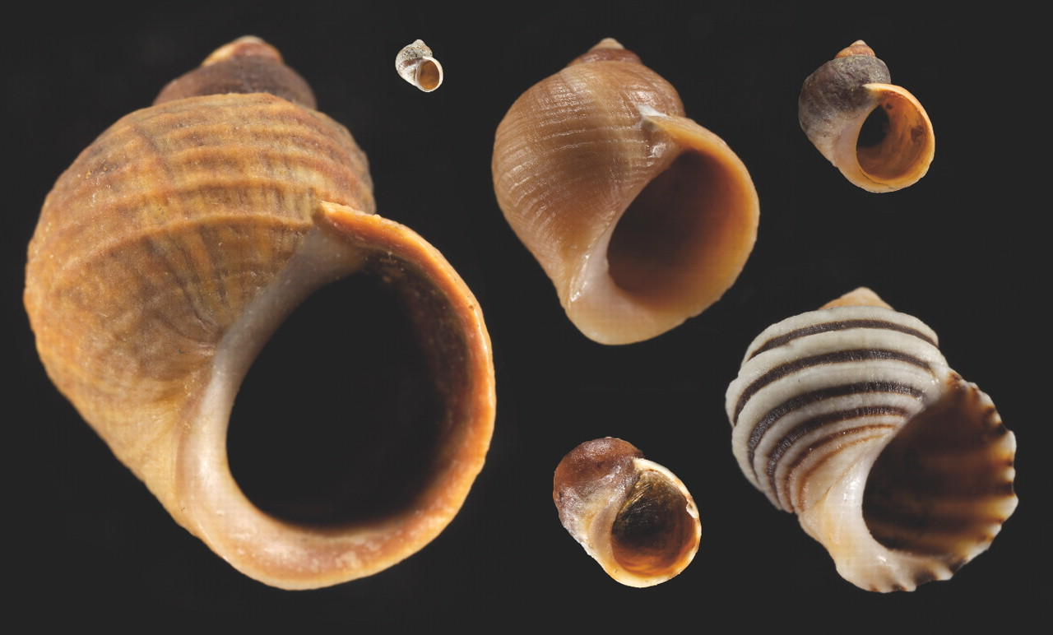
Littorina saxatilis L.
Sweden
Spain
Johannesson et al (2010) Phil Trans Roy Soc
Notes:
No need to introduce, morphological diversity but also lots of similar phenotypic divergence between populations
Focus on parallel evolution in Swedish populations

Slide 3
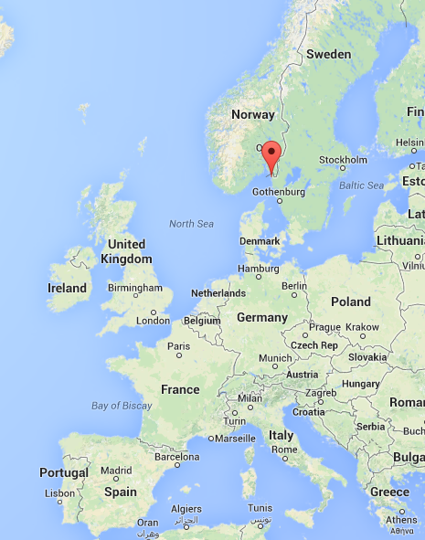
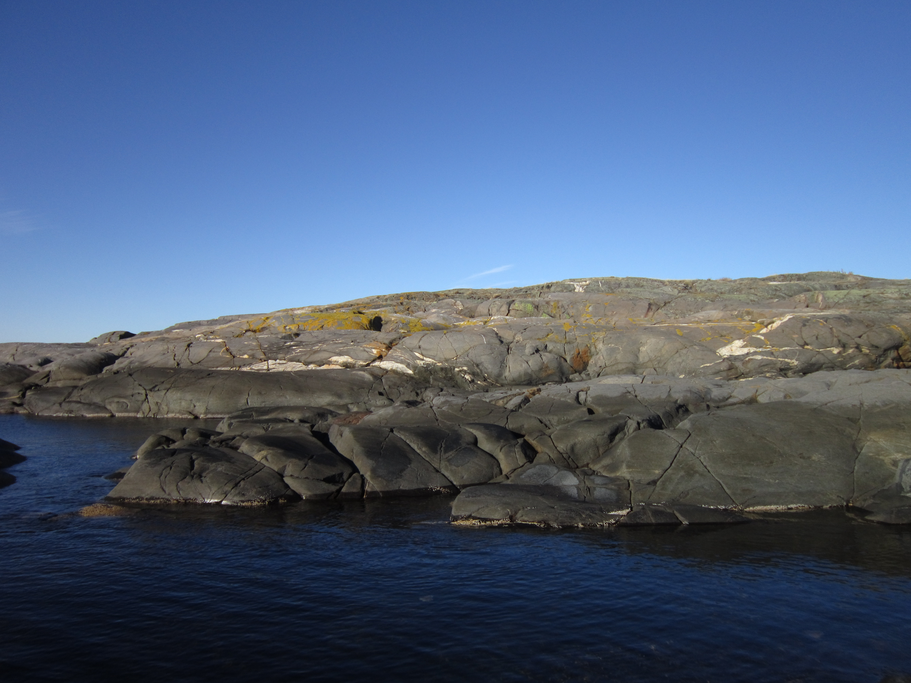
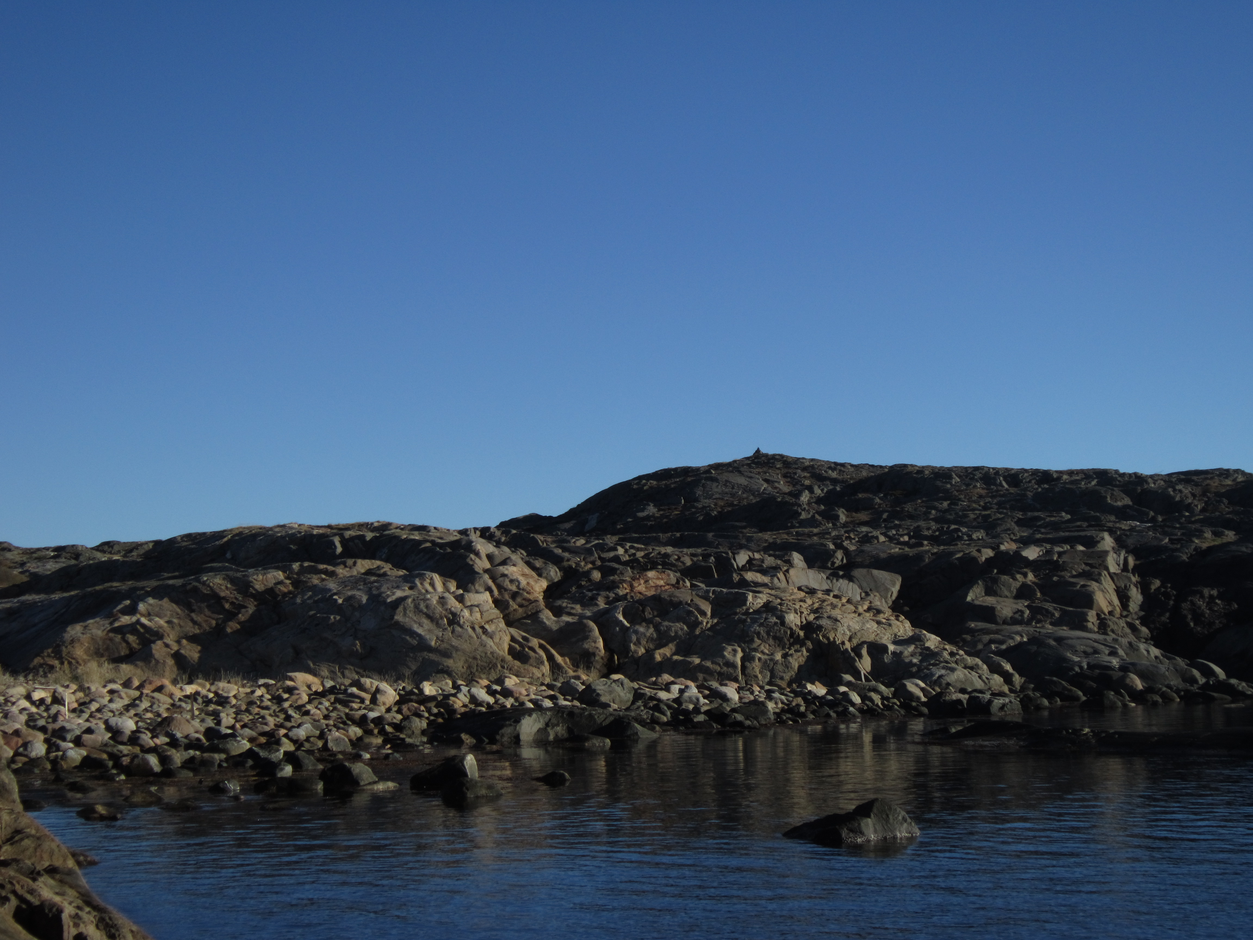
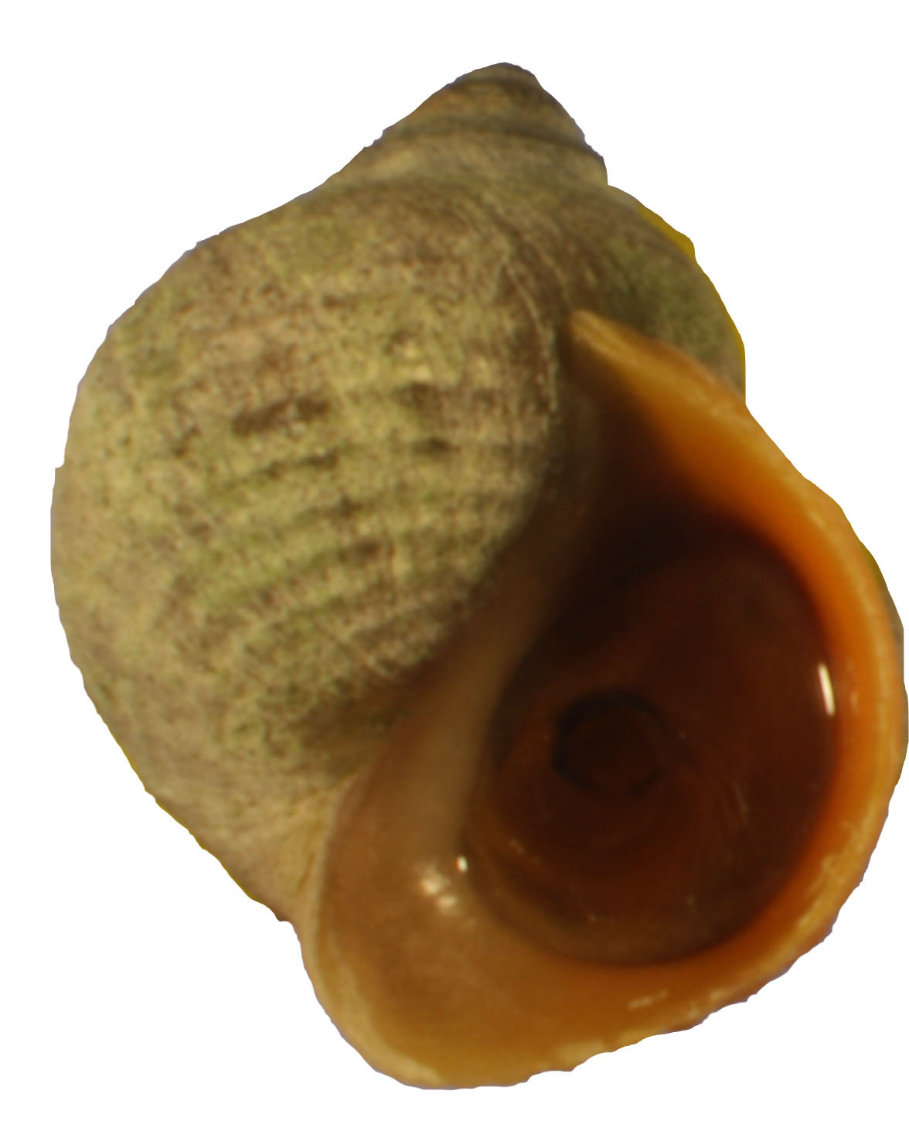
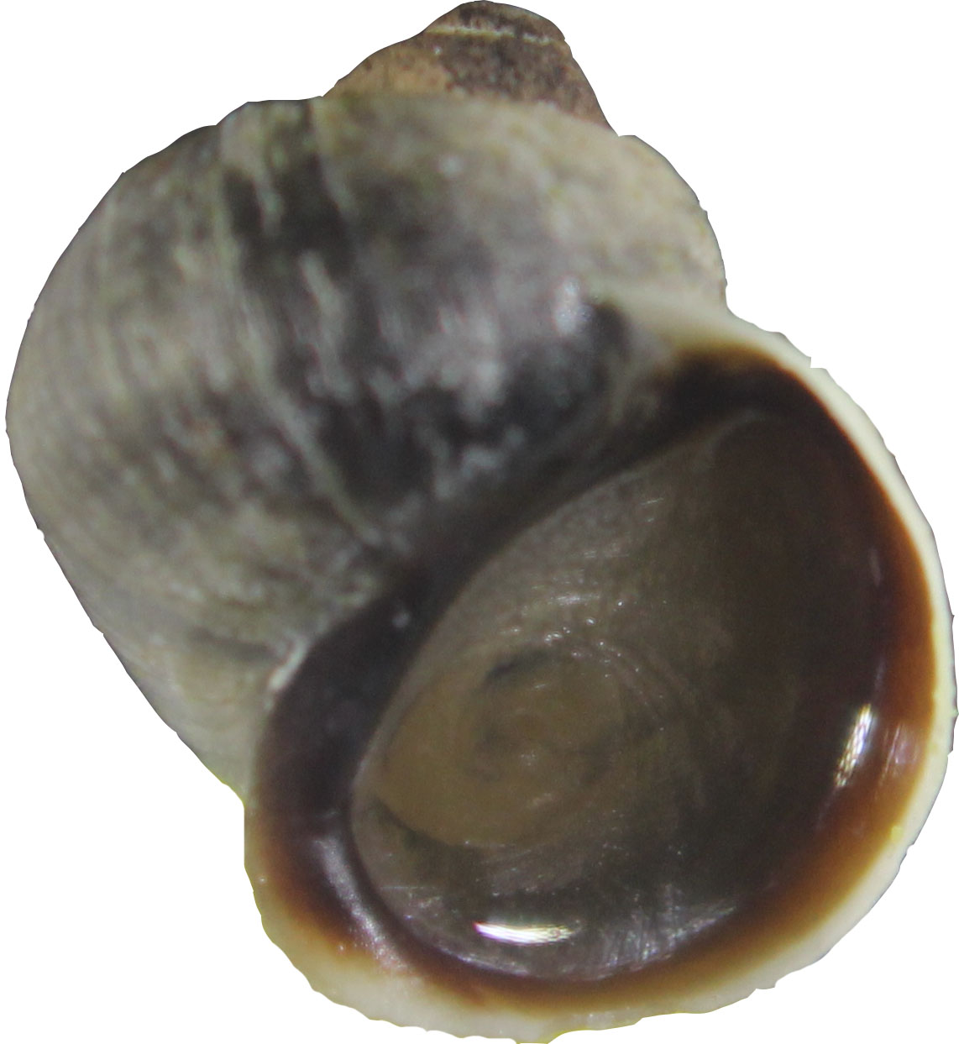
Swedish ecotypes
Divergence between cliffs and boulder habitat – Western Sweden
Cliff
Boulder
WAVE ECOTYPE
(AKA EXPOSED)
CRAB ECOTYPE
(AKA SHELTERED)
Cliff habitat
Wave action
Smaller
Thinner shell
Bold
Boulder habitat
Crab predation
Larger
Thicker shell
Less bold

Slide 4
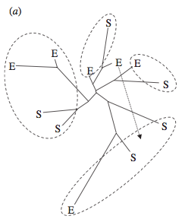
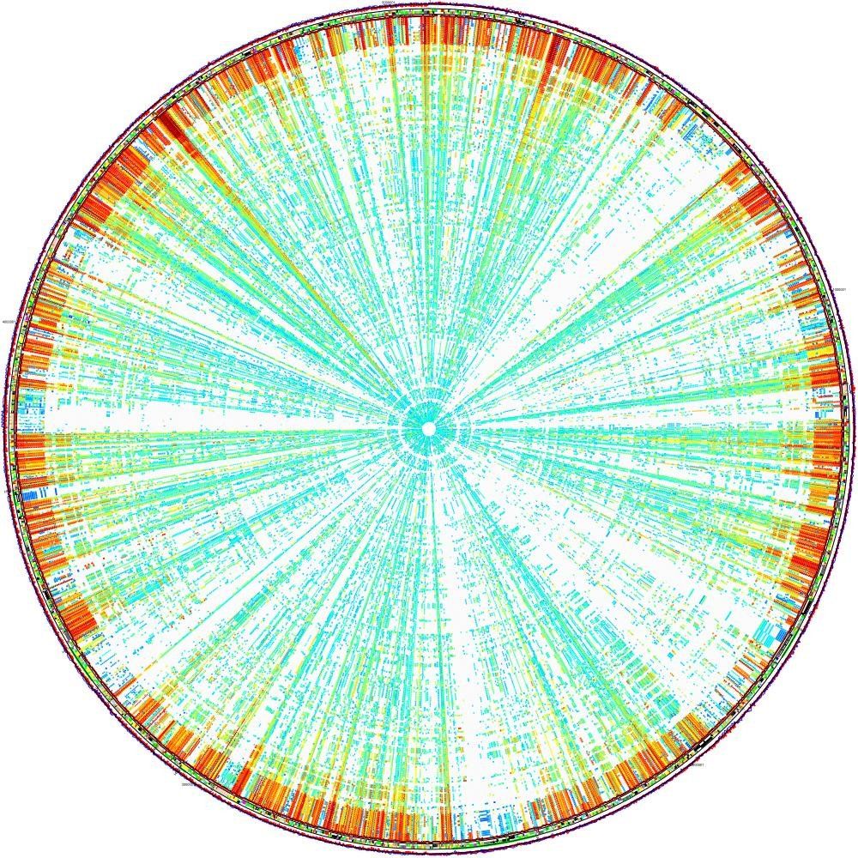
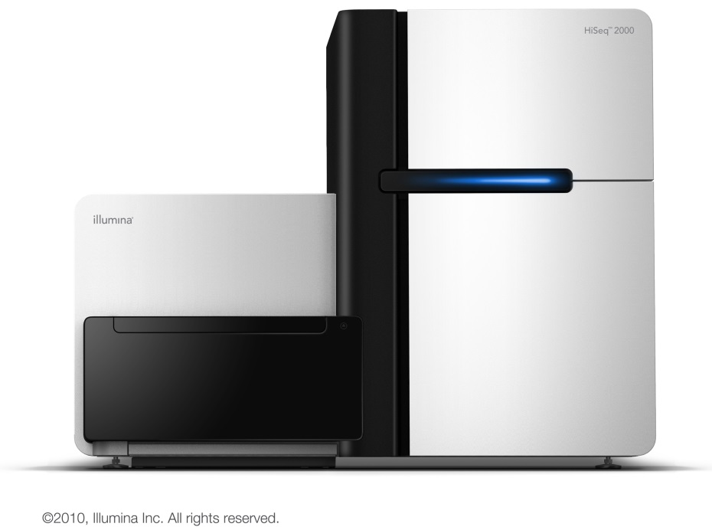
Parallel evolution - Littorina
Repeated, independent evolution of ecotypes in the face of parallel selection
Are the same genes involved in parallel evolution on this small scale?
How parallel is this parallelism?
Wave
Crab
Panova et al (2006); Makinen et al (2008); Johannesson et al (2010)
Notes:
How parallel – are the same genes underlying traits, we now have power to find out

Slide 5
Rationale
Top-down approach using high throughput sequencing to identify:
Loci experiencing positive parallel selection between ecotypes
Loci strongly associated with ecotypes across islands
Loci strongly associated with phenotypic variation within ecotypes

Slide 6
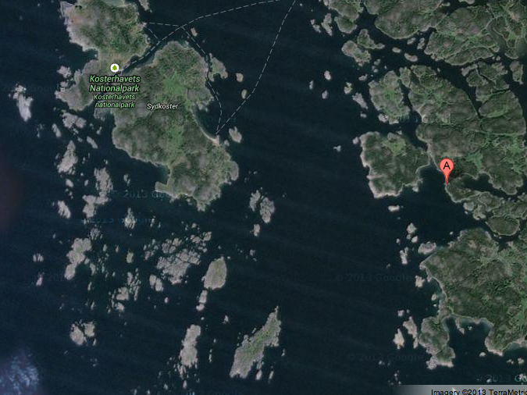
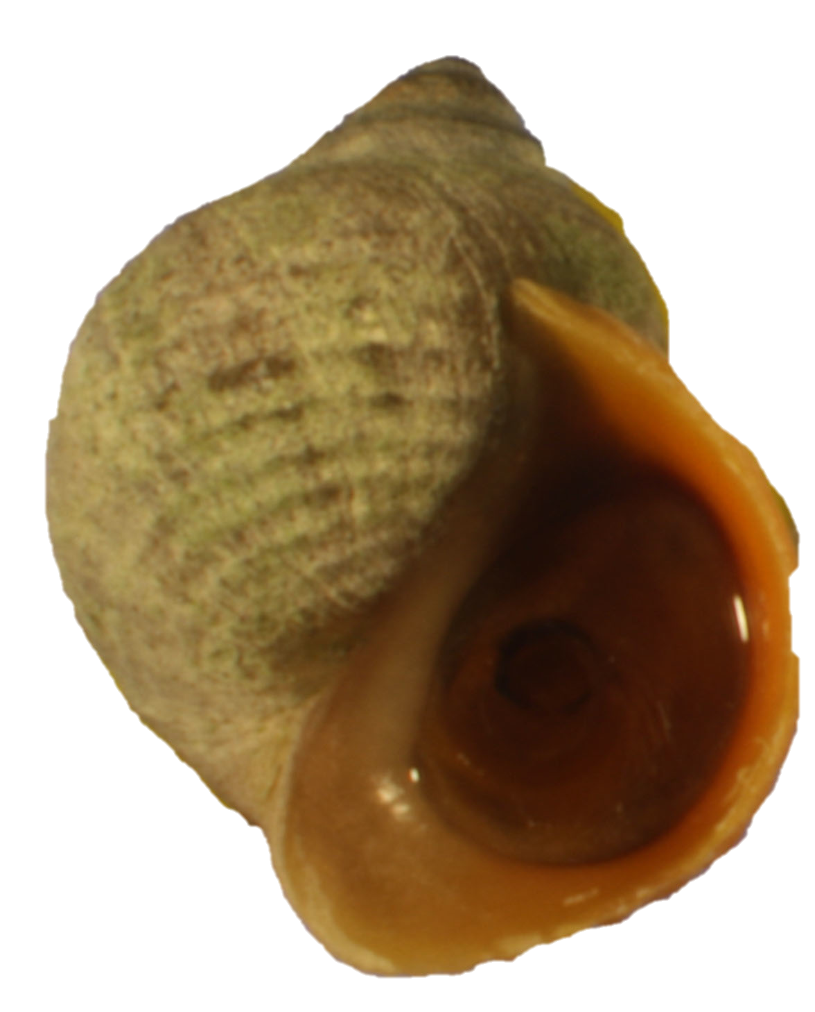
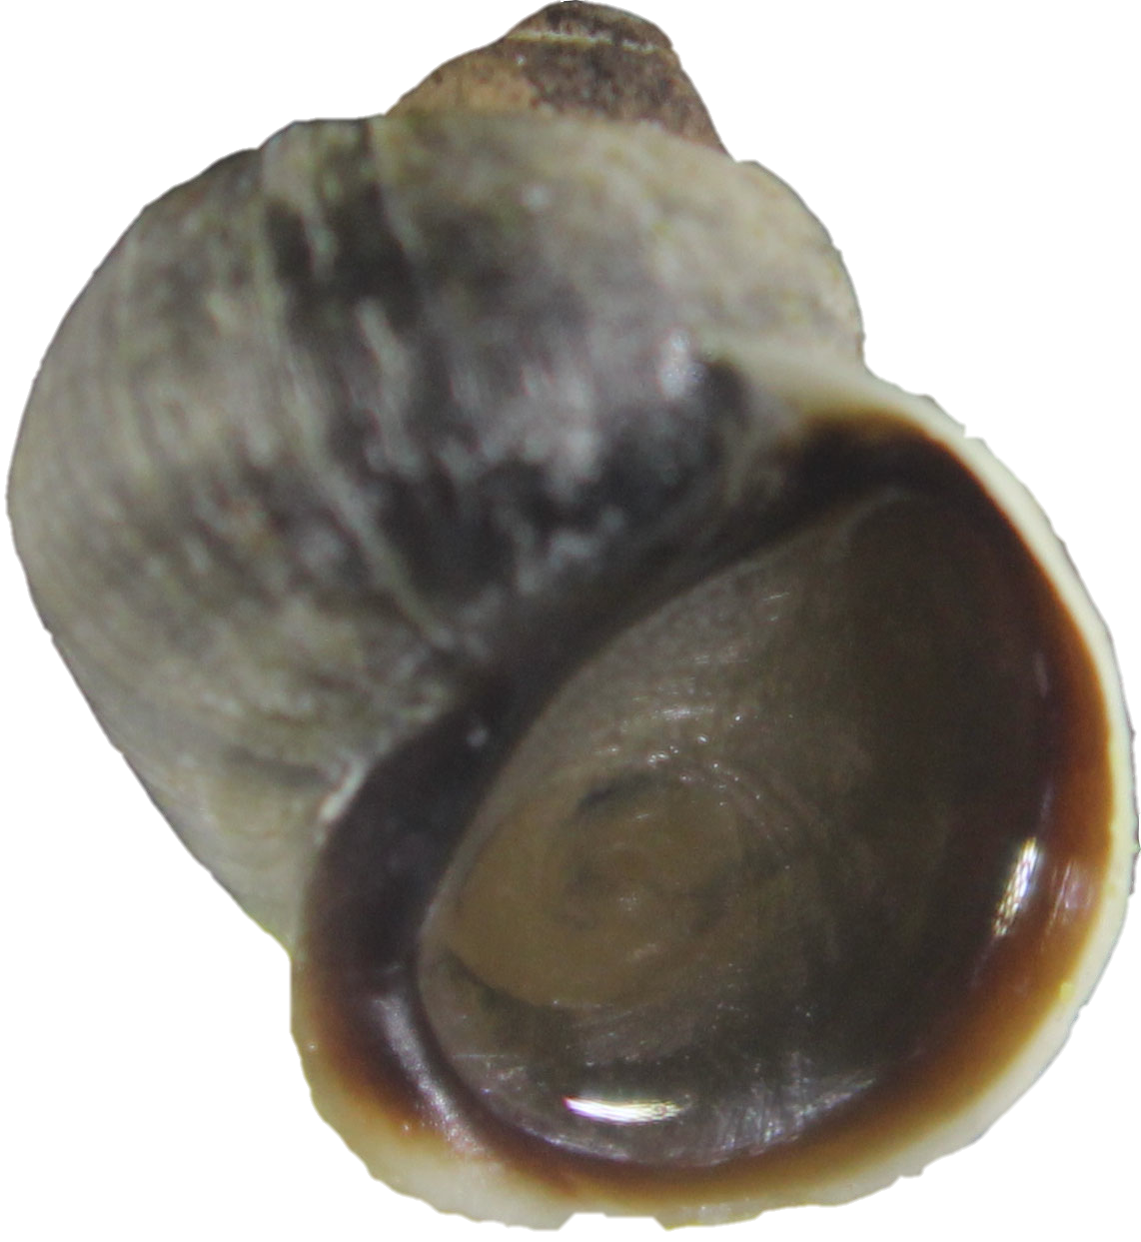
Methods – sampling sites
Three islands on Swedish coast – two ecotypes present on each
Map of sites
Numbers of individuals
General design
Saltö
Jutholmen
Ramsö

Slide 7
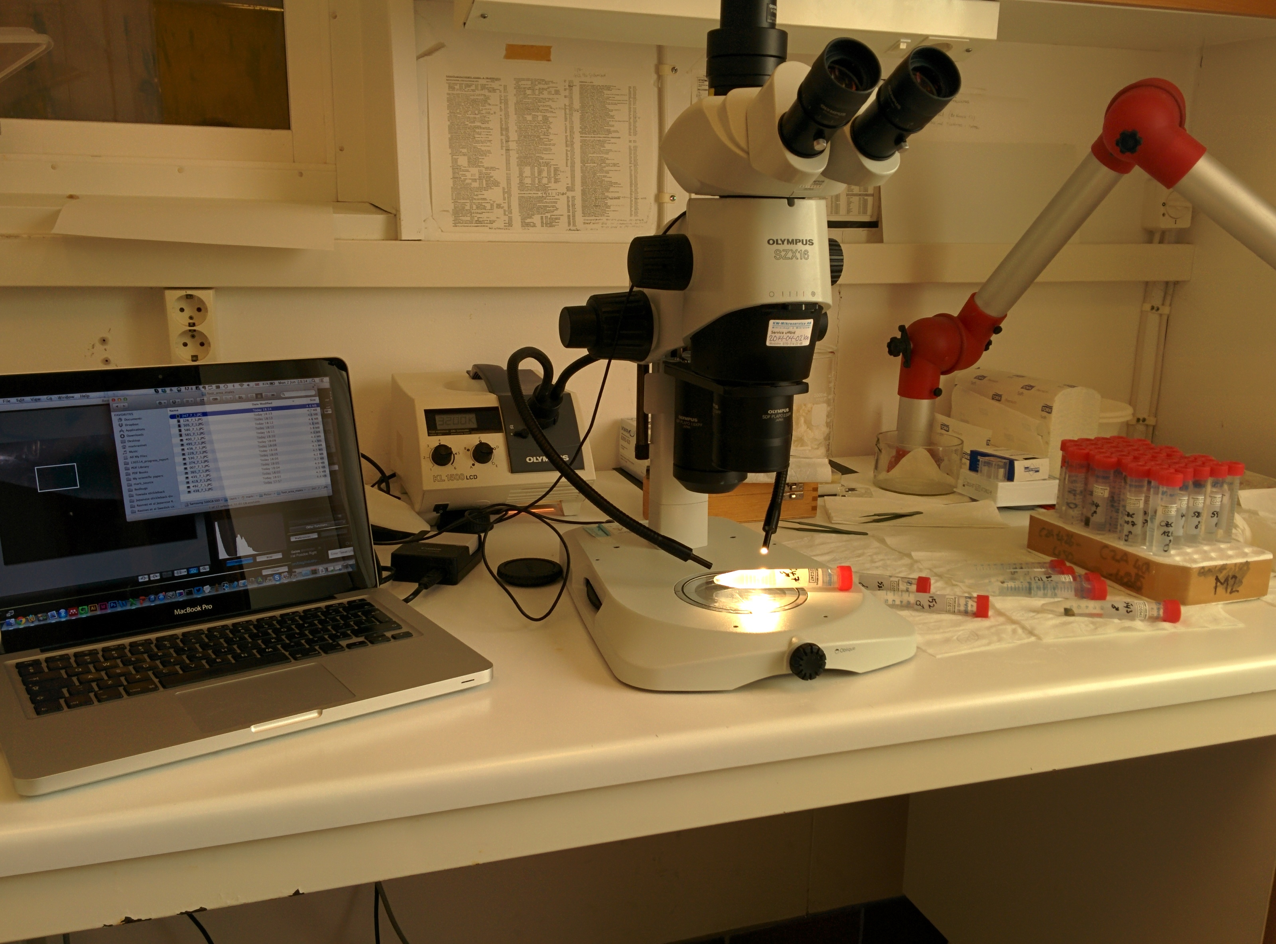
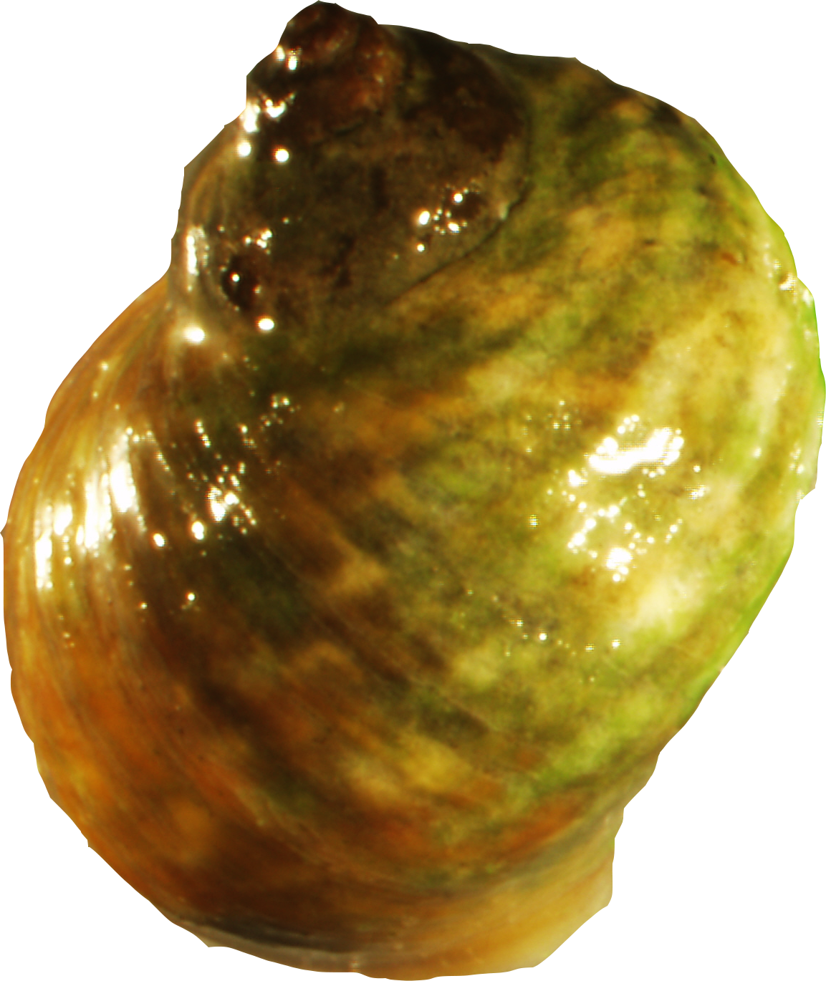
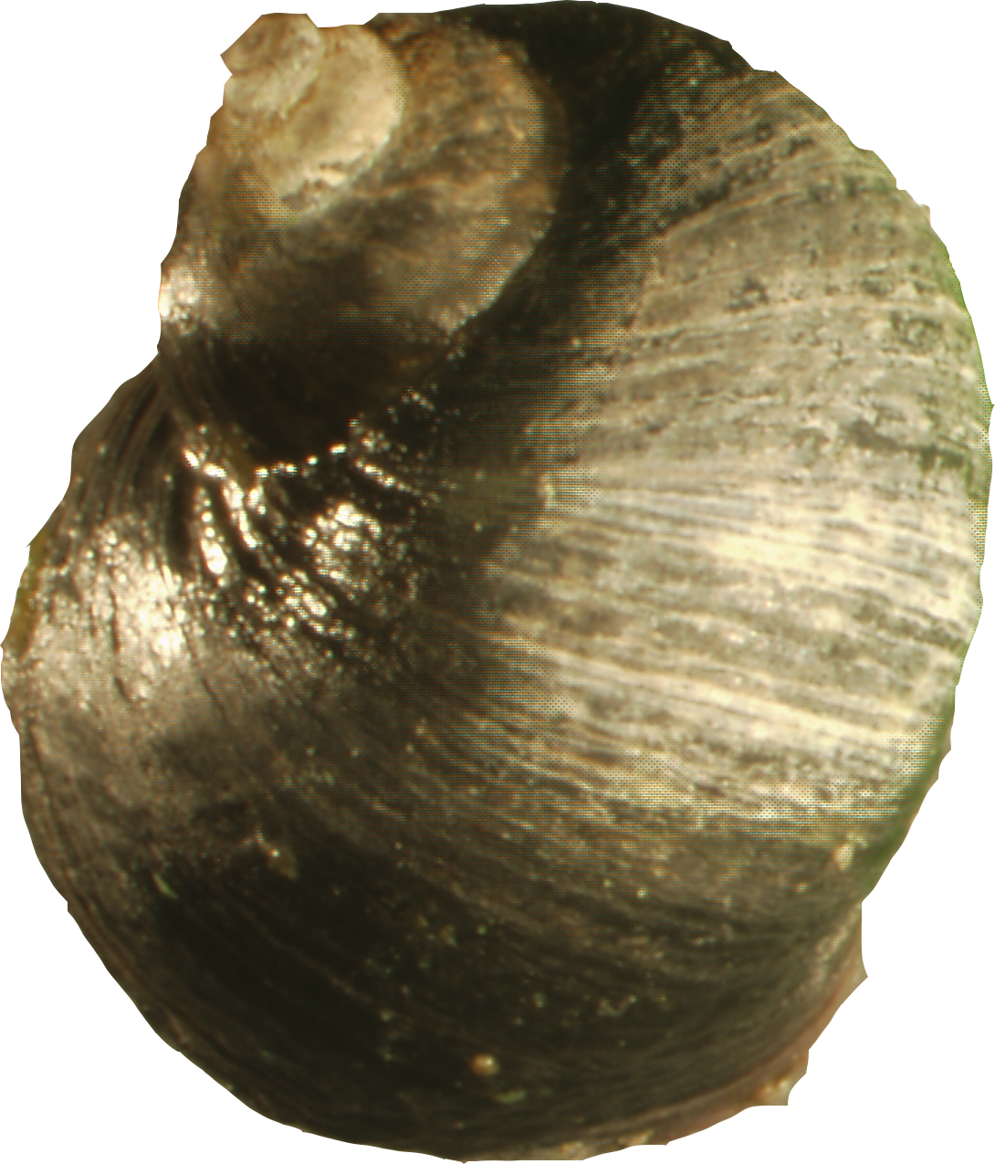
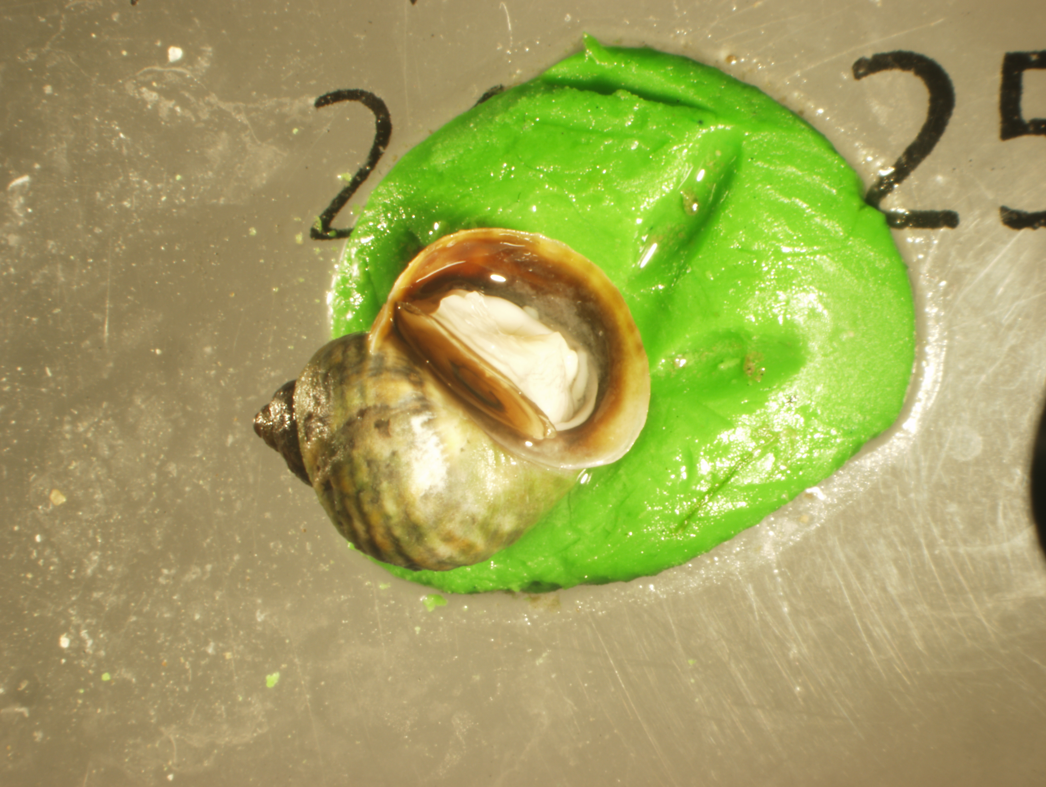
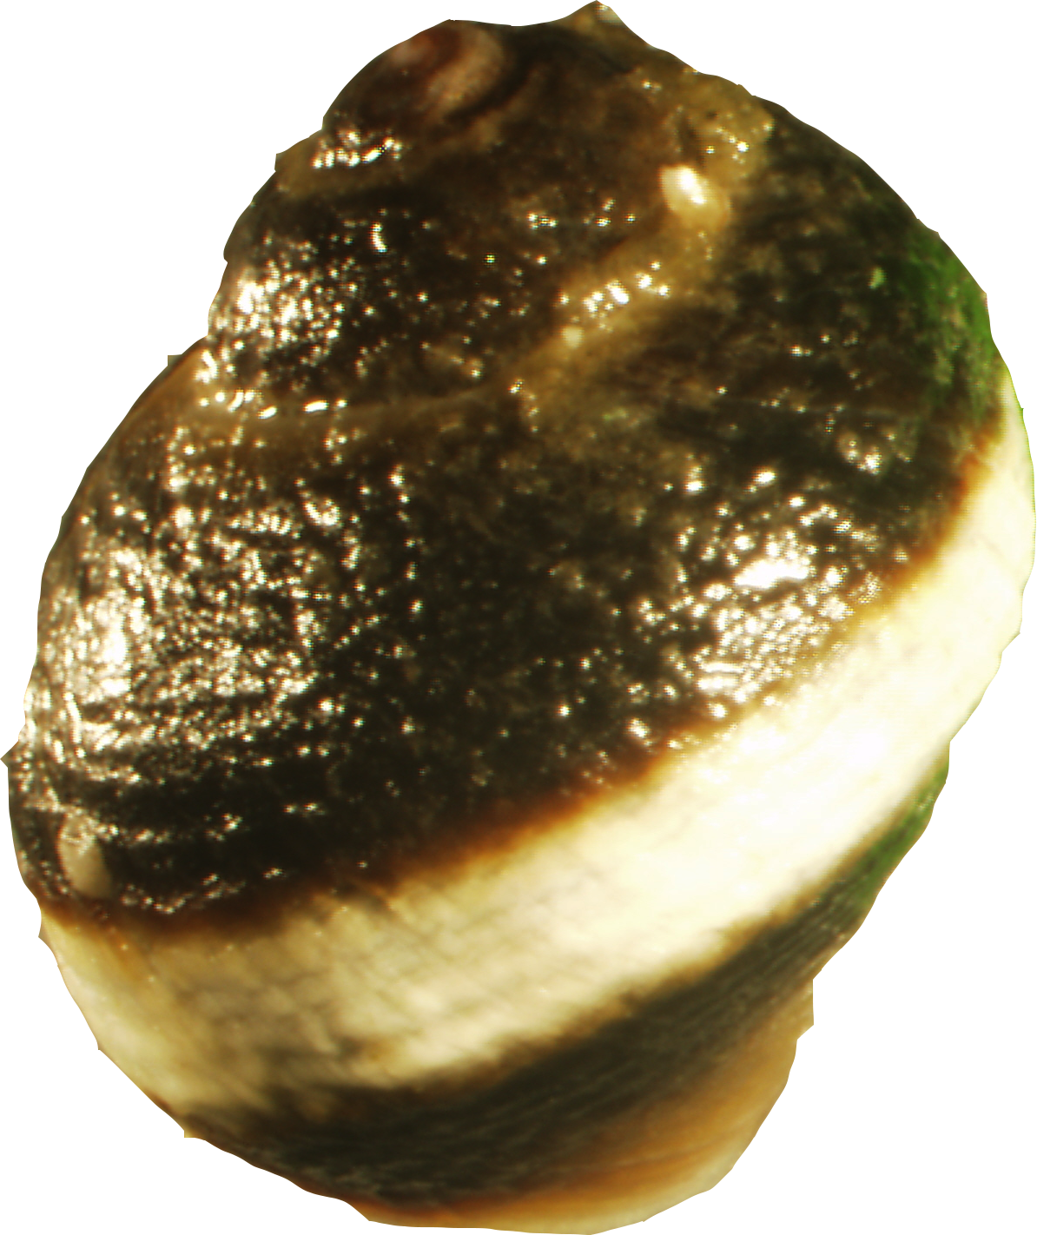
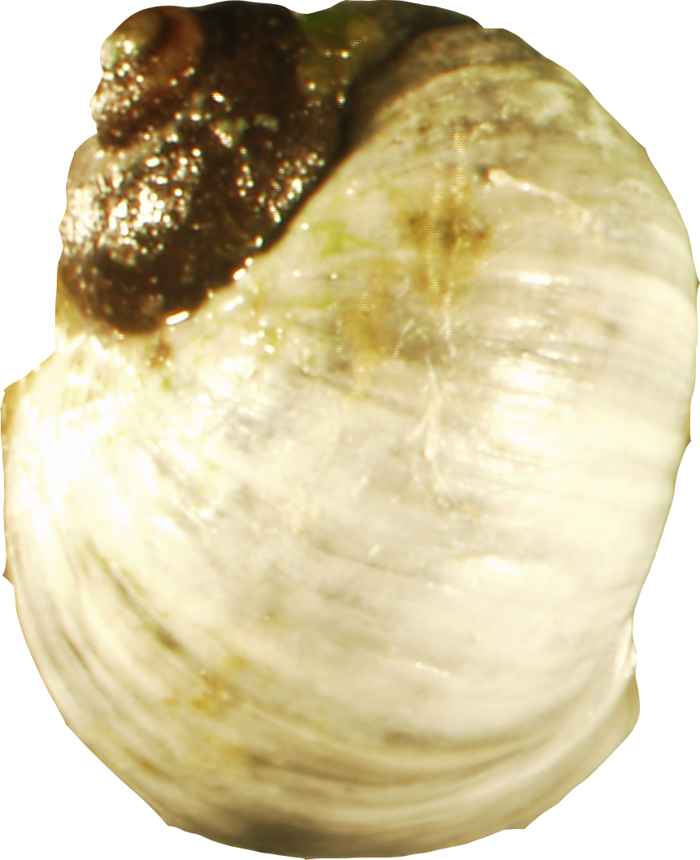
Study design
144 individuals – Ramsö, Saltö, Jutholmen
Geometric morphometrics and phenotyping
24 crab
24 wave
48 per population
Restriction-site associated DNA (RAD) sequencing

Slide 8
RAD-sequencing in brief
Single digest RADs – Baird et al (2008)
simple example with two individuals
introduce restriction enzyme
Ind A
Ind B
Sbf1
5’…CCTGCAGG…3’
3’…GGACGTCC…5’
Sequence 100 bp including barcode and restriction site
Notes:
Double RAD tags – 6 here 12 total
Mention missing RADs – i.e. SNPs in RAD site

Slide 9
RAD loci: reference genome
Align reads to a reference genome
Identify RAD loci and call SNPs
Simple!
Locus A
Locus B
Locus C
Locus D

Slide 10
RAD de novo assembly
de novo assembly is more complicated
Must match identical sequences

Slide 11
RAD de novo assembly
de novo assembly is more complicated
Must match identical sequences into stacks
Essentially alleles…

Slide 12
RAD de novo assembly
de novo assembly is more complicated
Alleles matched within individuals
Loci matched between individuals
Both use nucleotide differences
Locus A
Locus B
Locus C
Locus D
Locus A
Locus B
Locus D
Ind 1
Locus A
Locus B
Ind 2

Slide 13
Some RAD issues
High nucleotide diversity can make de novo assembly difficult
Always a balance:
too low – alleles called as separate loci
too high – loci are merged
Notes:
BALANCE

Slide 14
De novo assembly and filtering
8 nucleotide differences within and between individuals
103 919 loci across all 144 individuals
Filtering – must be polymorphic, must occur in >50 % individuals on an island
~9400 loci per island – but further filtering required…
Likelihood-based test to remove loci with sex linkage
Homozygosity excess

Slide 15
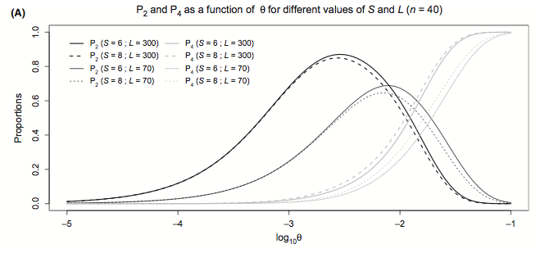
Null alleles
Caused by mutations disrupting restriction site
Ind A
Ind B
Normal homozygote
Null homozygote
Normal heterozygote
Null heterozygote
Θ (4N_{E}μ)
Called as homozygotes causing homozygosity excess
Gautier et al (2013) Mol Ecol
Notes:
Two types
Nulls are where a mutation occurs here, restriction site cannot cut
Null seg in popn – null homozygote not a prob
Null heterozygote – erroneously called as homozygote
Also if many seg, inds homozygous for two null alleles – not genotyped at all
Increasing proportion with theta – EXPLAIN AXES

Slide 16
Strict filtering
Three different datasets, one for each island
9281 loci
~1/3 shared between all three islands
~1/3 are unique to each island

Slide 17
Quantifying parallelism
Strong parallel evolution of shell morphology amongst ecotypes
Genomic parallelism is low
10 %
12 %
8 %
Factor | PVE
Ecotype | 90%
Island | 37%
Interaction | 39%
Binomial GLMs
MANCOVA and PVE estimation

Slide 18
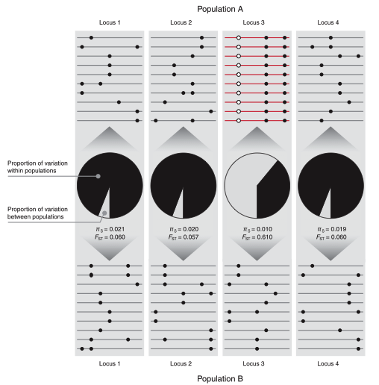
Detecting outliers using F_{ST}
Reduction of within-population diversity relative to increase in between-population diversity
fdist – coalescent simulations to estimate expected neutral F_{ST} distribution
Loci outside 99% CI are potentially under selection
Beamont & Balding (1996) Proc B; Storz (2005) Mol Ecol
Notes:
See Locus 3 outlier – other loci show low differentiation – so again the need to LOOK AT MULTIPLE LOCI

Slide 19
Identifying selection
Fdist outlier analysis – 5% FDR
6448 total loci
954 positive outliers
15%
6105 total loci
1017 positive outliers
17%
6669 total loci
794 positive outliers
12%

Slide 20
Shared outliers
What proportion of loci are shared outliers?
0.5 % shared between all three islands
~1% shared by two islands
~7% are unique outliers

Slide 21
Other outliers
Strong linkage disequilibrium between loci may indicate genomic inversions, local adaptation or population structure
LDna – network analysis of linkage disequilibrium
Blocks of loci associated with each other
Notes:
Quite complicated, not enough time to explain in detail but goes across blocks of linkage looking for clusters

Slide 22
Ecotype clusters
274_0.25 with 10 loci contributes strongly to ecotype difference
Includes two outliers shared between all three islands and five which are outliers on at least one island

Slide 23
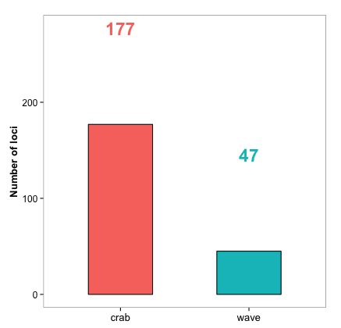
Other outliers
Ecotype specific loci
Highly divergent (i.e. ancient) alleles may not merge in a de novo assembly
Screened dataset for loci fixed in one ecotype but not present in the other
Locus A
Locus Z

Slide 24
Summary
De novo RAD assembly can be problematic for Littorina saxatilis and null alleles make things worse!
Our top-down approach has identified loci under parallel selection, loci associated with ecotype and loci associated with phenotype
The next step is to try use these loci to identify the genes that may be involved in ecotype formation

Slide 25

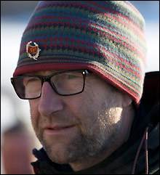
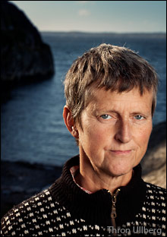
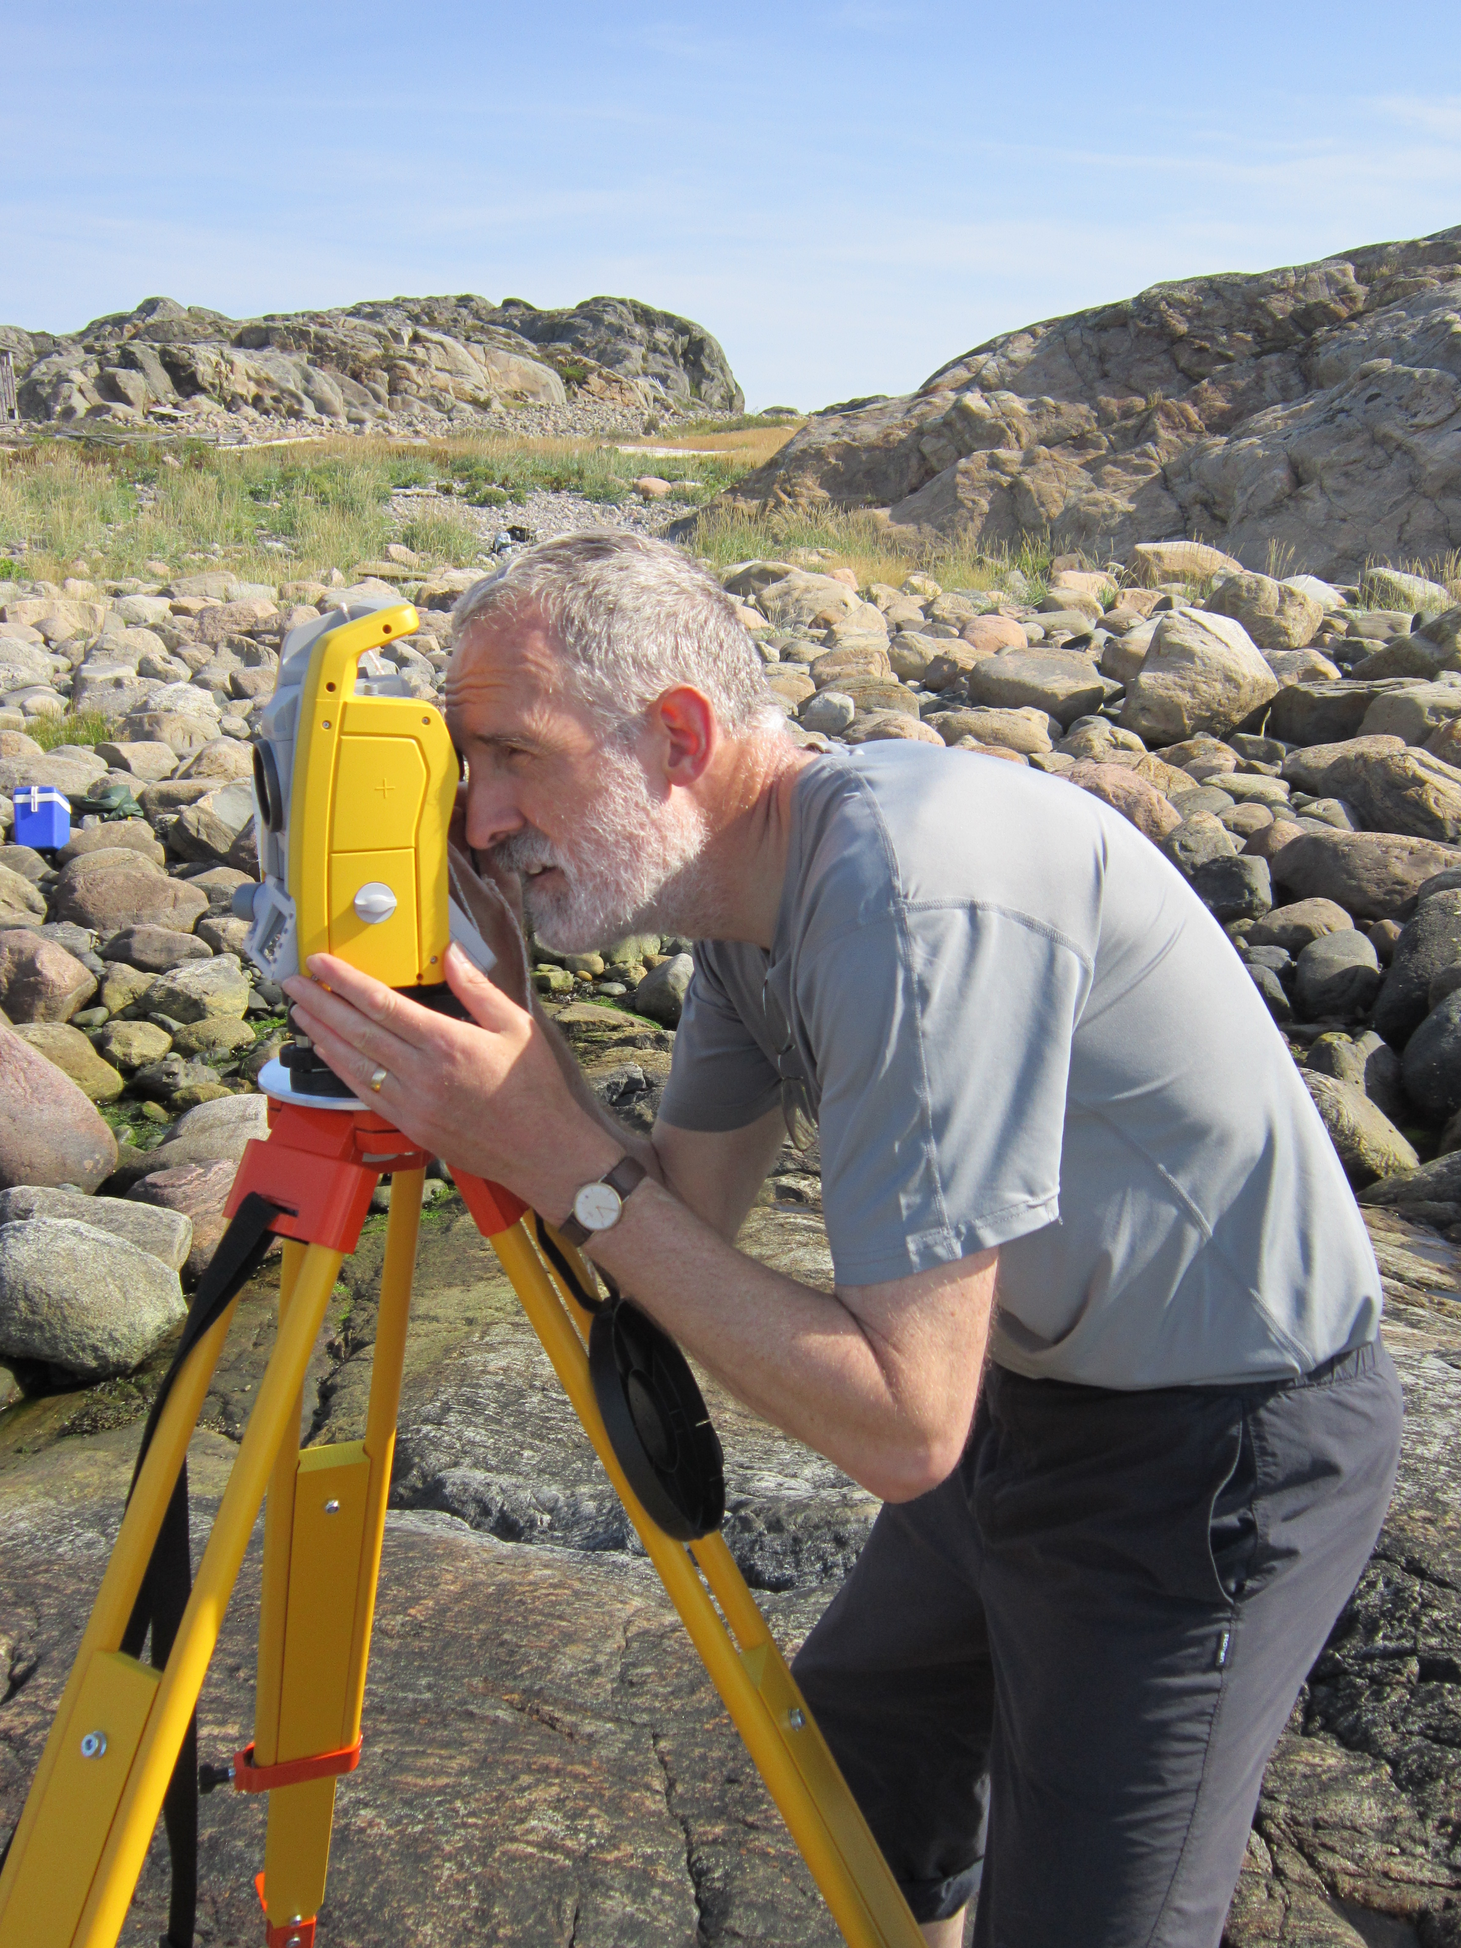


Acknowledgements
Kerstin Johannesson
Marina Panova
Carl André
Roger Butlin
Valuable assistance:
Anja Westram
Kevin Keenan
Petri Kemppainen

Slide 26
Wave-type colour phenotypes
Association tests using binomial GLMs.
Loci above 99th quantile of PVE.
17 loci
12 loci
17 loci

Slide 27
RAD loci: reference genome
Align reads to a reference genome
Identify RAD loci and call SNPs
Simple!
Locus A
Locus B
Locus C
Locus D

Slide 28
Ecotype clusters
289_0.24 with 11 loci also contributes strongly to ecotype difference
No shared outliers but 6 of the 11 loci are outliers on at least one island

Slide 29
Dealing with null alleles
No established method for RADs
Implemented 2 microsatellite methods
HWE to estimate frequency of null alleles
Correct observed allele frequencies and downstream estimates – i.e. F_{ST}

Slide 30
Population structuring
Population structure not clear for non LD loci
Strong LD loci show mixture of ecotype and population structure
Discriminant analysis PCA with k means clustering

